Slide 1


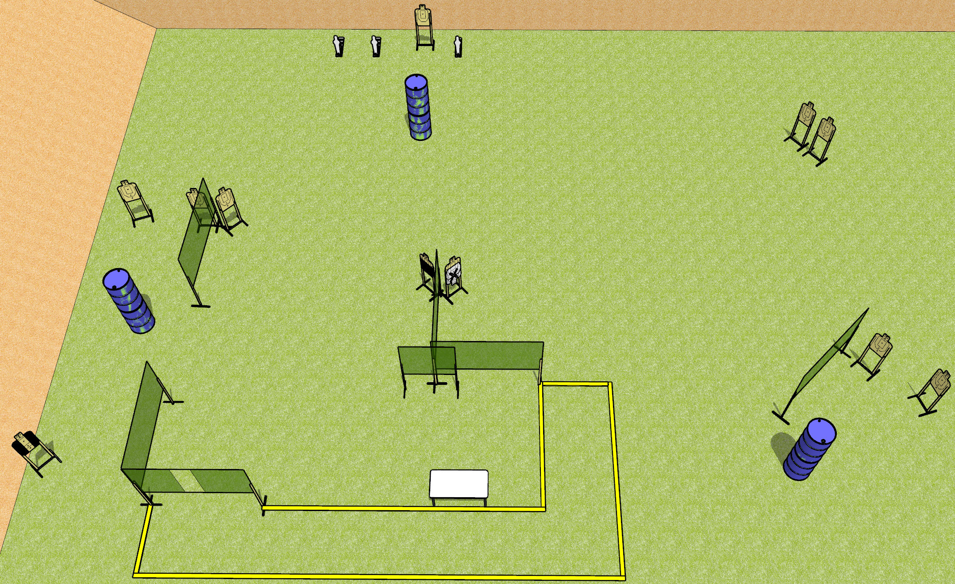
 | Dothan Gun Club – USPSA Match Get Em And Go Course Designer : Drew Coleman
Round Count 25 rounds 11 USPSA 3 mini poppers
Equipment List 12 wall feet Table 1 tux, 1 50%, 10 targets (9 + 1 NS)

Slide 2
Get Em And Go
Written Stage Briefing
Scoring: Comstock
Rounds: 25
Targets: 11 USPSA, 3 steel
Start Position: Anywhere completely outside the shooting area, toes touching rear fault line. Firearm is unloaded and unpropped, trigger guard on mark. All magazines to be used on stage on table.
Stage Procedure: on the audible start signal, engage targets as they become available from within the shooting area.

